Slide 1



Why Air Travel is safe?
Notes:
Travelling in airplane is making your life at risk. Air travel is risky compared to other modes of transportation. Likewise, there has been a lot of chatter in the media regarding the airline crashes and fatalities occurred in recent times. With several incidents in recent times, you might get an impression that these days, you are taking your life at stake by travelling in airplane instead of other modes of transportation like automobiles. Should you really worry to travel in airplane? Let’s look at the data before drawing a conclusion.

Slide 2
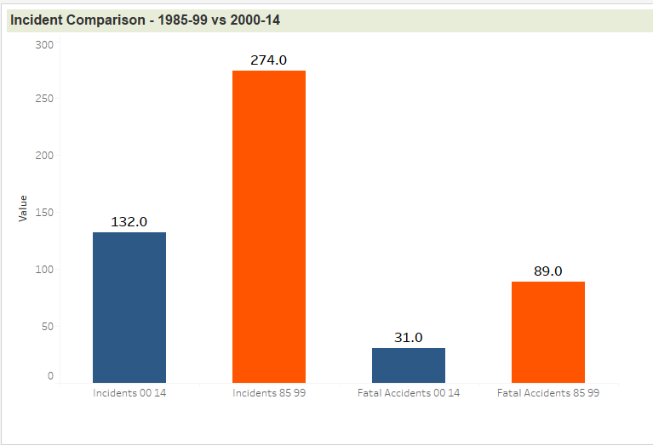
Air Incidents and Fatal Accidents
Reduced by 67%
Notes:
Looking at the chart we can understand the air incidents have been reduced substantially in the current decade compared to the decade before. In the decade lasts between 1985-99, the total number of incidents was more than 250 which has been reduced below 100 during 2000-14. This is nearly 67% reduction. This is mainly due to several safety measures taken by Airline companies to safeguard their passengers

Slide 3
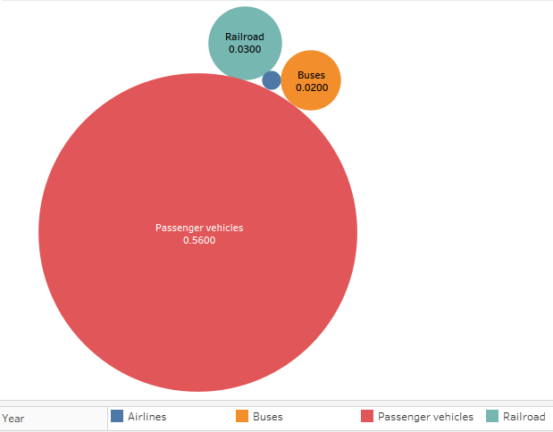
Death Rate per 100M passenger miles
Airline: 0.0020
Notes:
Lets try to compare the airline travel with other transportation modes. Though it sounds like airline travel is unsafe, looking at the chart it is clear that air travel is still one of the safest modes of transportation. The chart shows the death Rate per 100M passenger miles for different modes of transportation. Air travel remains the lowest of 0.0020 compared to other modes of transportation and auto accidents remain the highest one.

Slide 4


Auto Accidents vs Air Accidents
Fatality risk is 0.23
Odds of dying is 1 in 107
Notes:
Next question that pops in everyone’s mind would be how safe is the road travel. Is it better compared to Air travel? At least, you are the one who is in control of the vehicle and can avoid the accident. Odds of dying in road accident is 1 in 107. However, fatality risk for air travel is 0.23. What is this number 0.23? Fatality rate of 0.23 means on a average a person would need to take a flight every day for 10078 years to be involved in accident

Slide 5
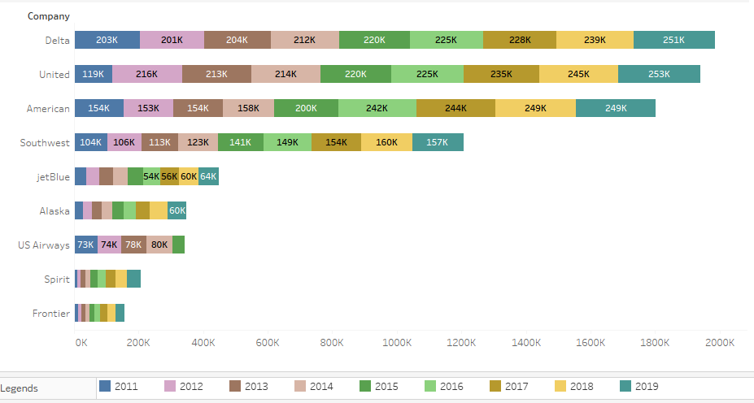

Available Seat Miles
Notes:
After considering all these facts, do you still think air travel is unsafe. If air travel is considered to be dangerous as media publishes, let us call out the number of passengers that travel by air per year. The number of available seat miles across Airlines increases year over year. This implies that people feel safe and their trust to travel via airlines increase over year.

Slide 6
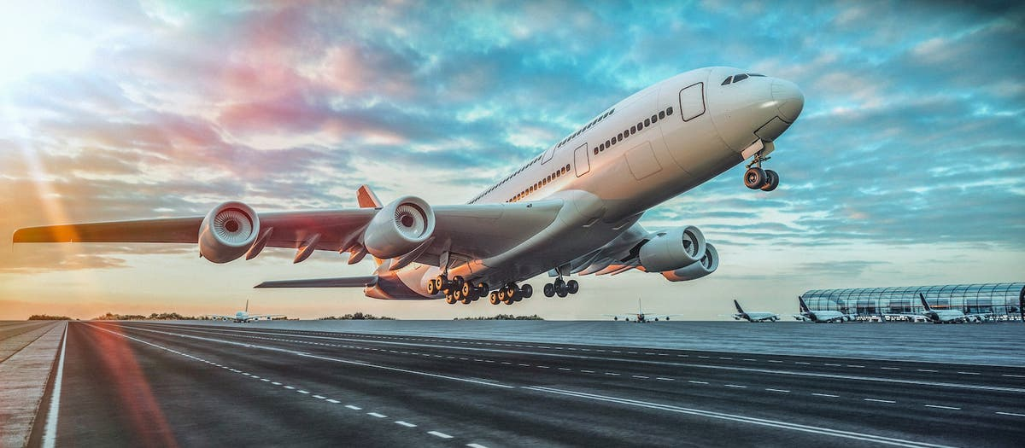
Thank you
Notes:
I would conclude that the media is spreading the false propaganda that air travel is exceptionally dangerous after a few recent incidents. However, based on data show, it is clear air travel is much safer mode of transportation, and while few incidents may have happened recently, it is not the only factor that needs to considered. So, air travel is in fact safe.

